Slide 1


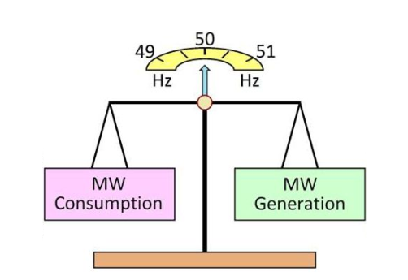
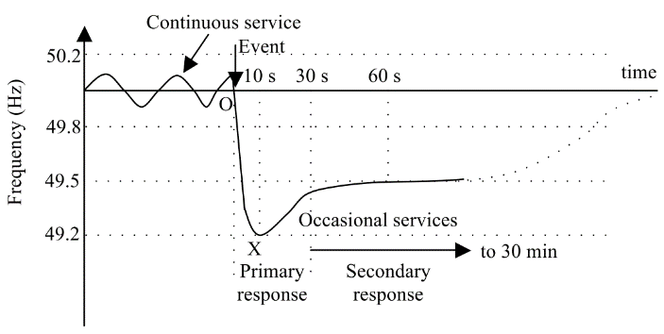
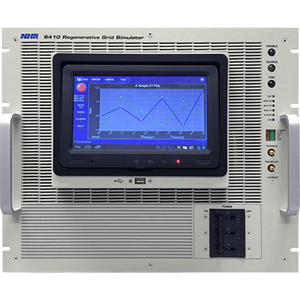
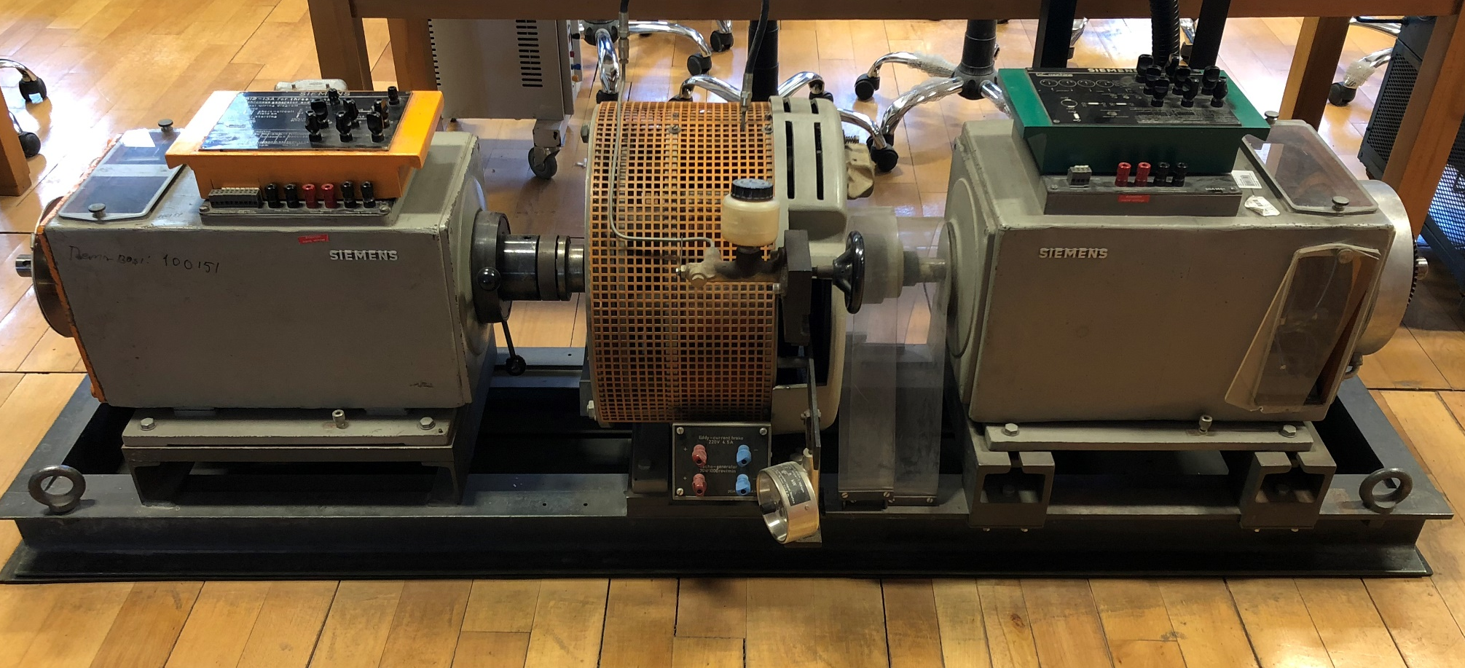
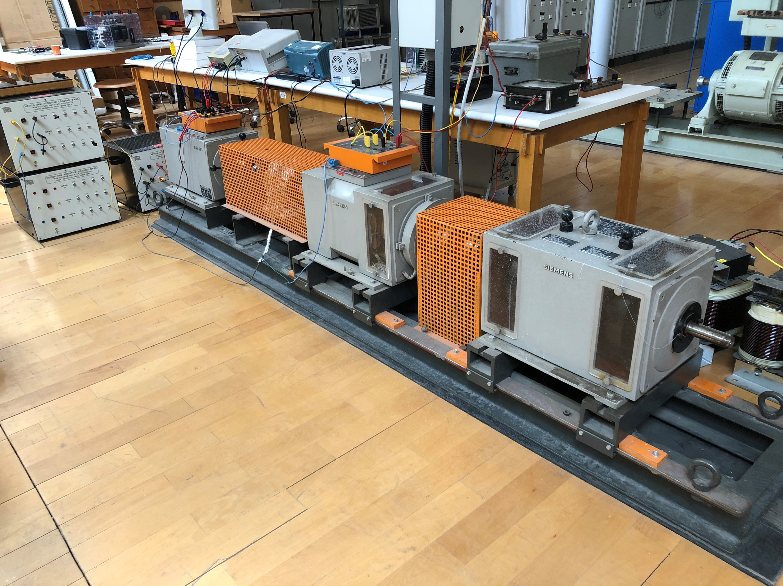
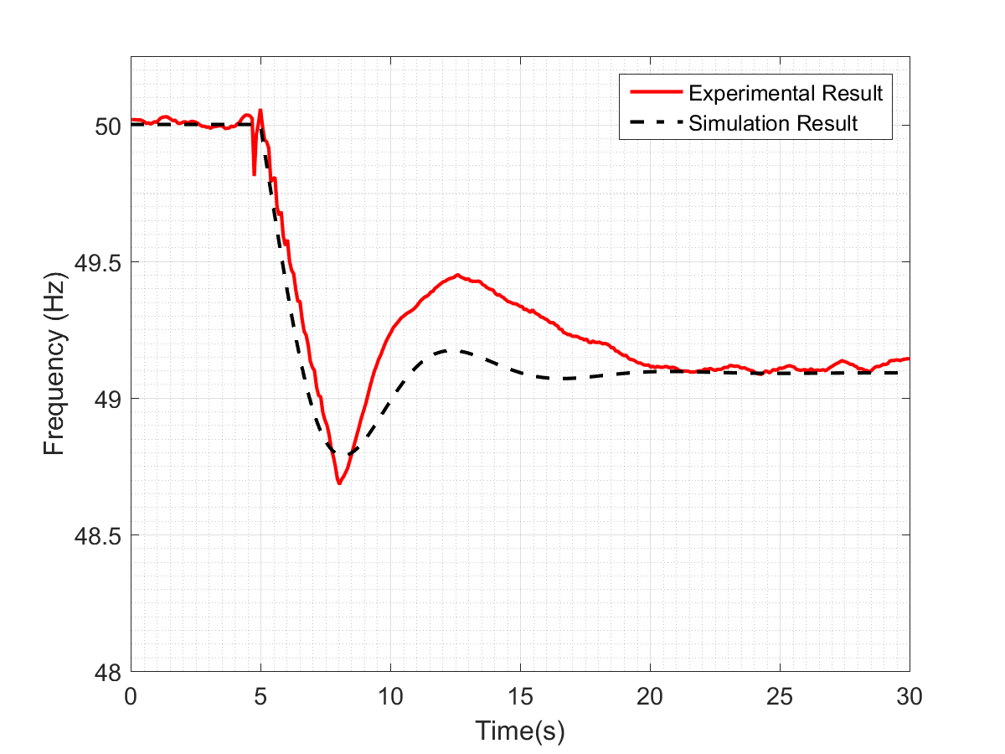
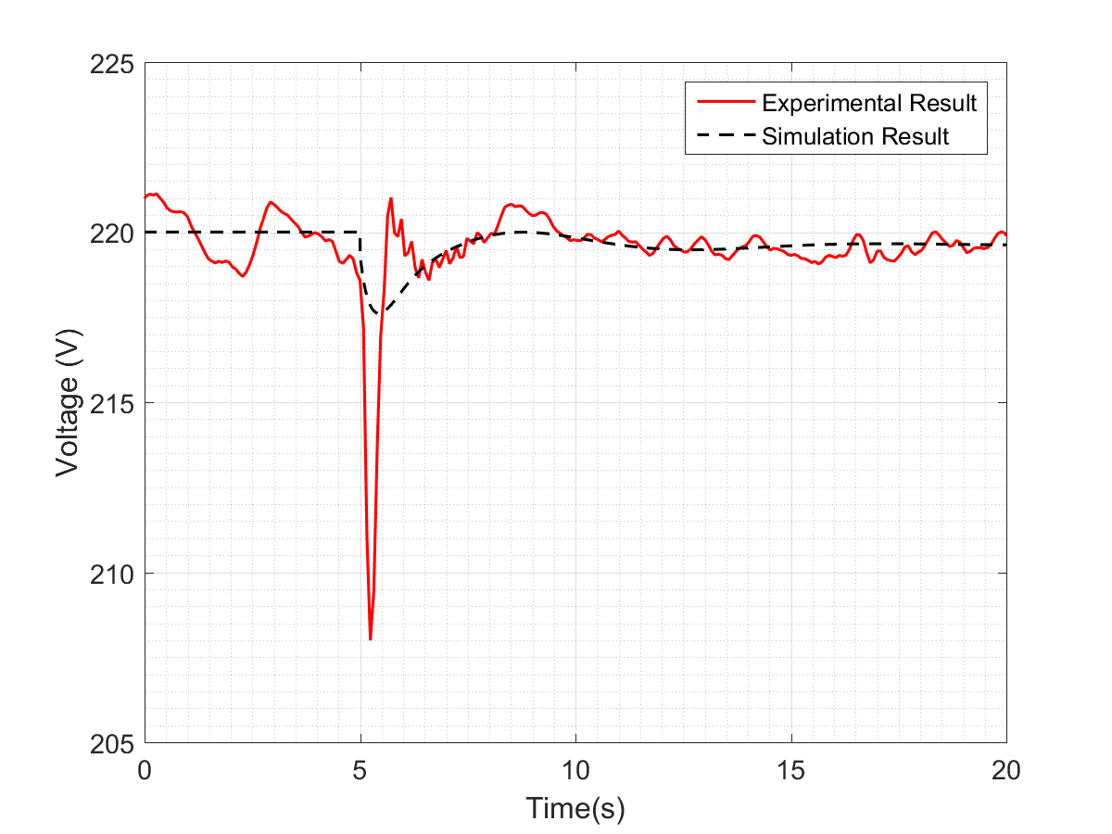
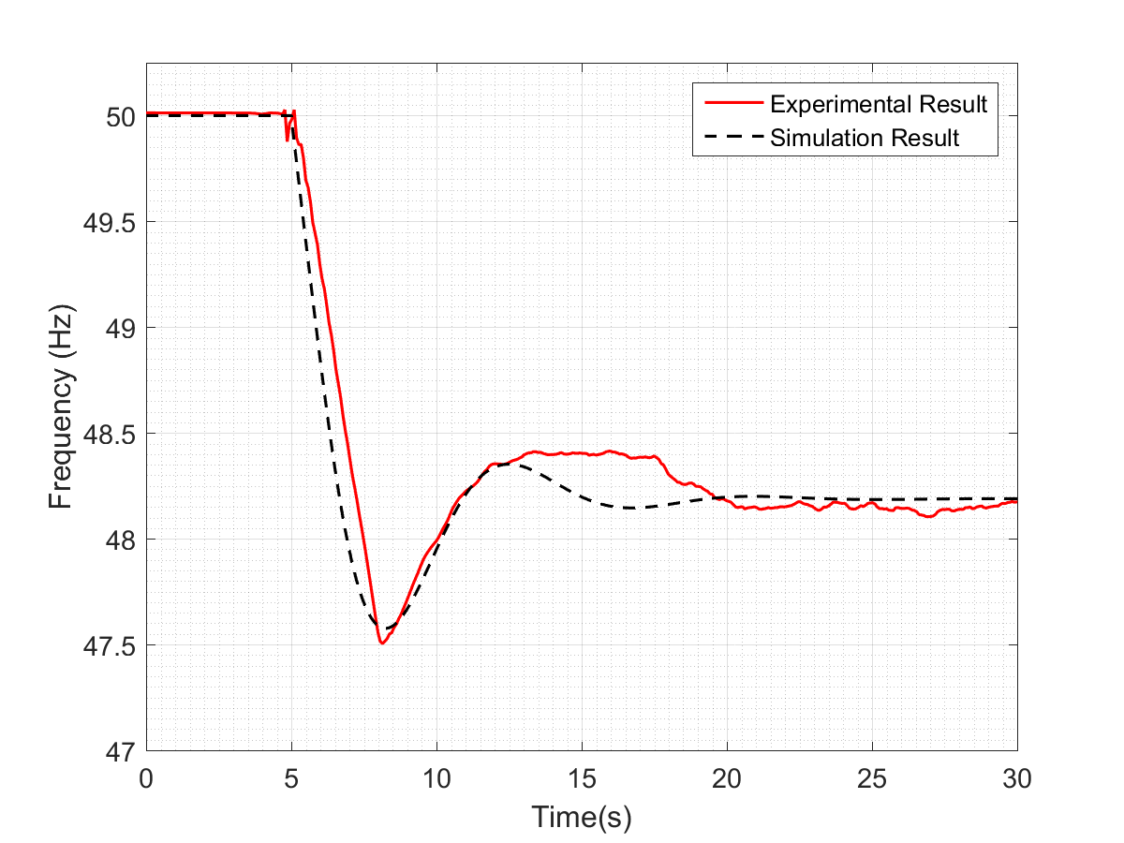
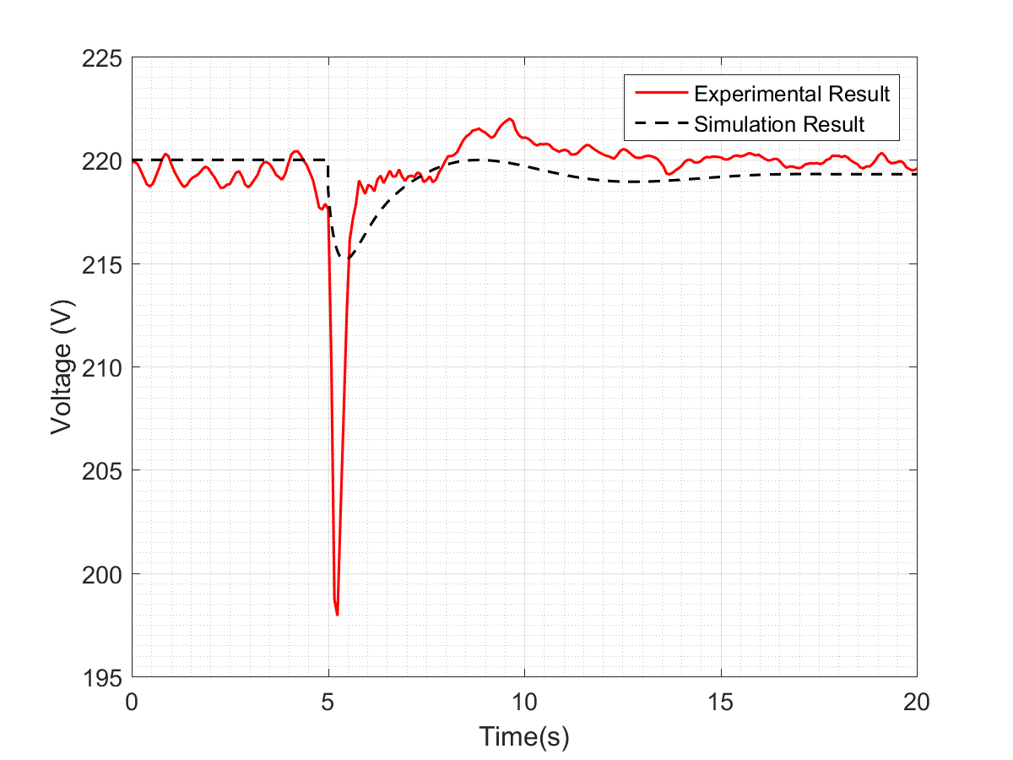

Design of a Grid Simulator for the
Dynamic Frequency Stability Studies
Erencan Duymaz
Advisor: Assist. Prof. Ozan Keysan
Middle East Technical University
GRAD STAR Research Workshop 2018
Frequency in Power Systems
System Description
Frequency in power systems depends on the balance between generation and consumption.
Increasing renewable energy systems causes higher flactuations in the frequency.
Figure 4. Proposed System Description
Governor
Exciter
It adjust the
output voltage.
It adjust the input mechanical power.
Figure 1. Frequency control in England and Wales [1]
AC Generator:
I_{f} α V_{t}
Therefore, frequency stability studies require higher attention. However, absence of dynamical grid simulators makes these studies more challanging in laboratory conditions.
Commercial Grid Simulator vs AC Synchronous Generator
Figure 5. Exciter Control Diagram
DC Motor:
ω α E_{a}
I_{f} α E_{a}
I_{f} α$\frac{1}{\text{I}\text{a}}$
I_{a} α T_{e}
Figure 6. Separately excited DC motor equivalent circuit [2]
Figure 2. Commercial Grid Simulator (left) and AC Synchronous Generator (right)
Figure 7. Governor Control Diagram for mode 1
There is no rotational part!
Frequency is commanded!
System is composed of rotational elements.
Frequency is determined according to power balance.
Figure 8. Governor Control Diagram for mode 2
Figure 9. Governor Control Diagram for mode 3
Proposal
Results
a. Frequency response for the 12.5% additional load connection
b. Terminal voltage for 12.5% additional load connection
Figure 3. Laboratory Setup ( AC Generator, DC motor and External Flywheel
c. Frequency response for the 25% additional load connection
d. Terminal voltage for 25% additional load connection
A realistic grid simulator can be designed in the laboratory by controlling the system speed and output voltage.
DC motor and AC motor will be controlled by controlling their field currents in order to deal with low power equipments.
Figure 10. Comparison of computer simulations and hardware results
Bibliography
[1] I. A. Erinmez, D. O. Bickers, G. F. Wood, and W. W. Hung, “NGC experience with frequency control in England and Wales-provision of frequency response by generators,” IEEE Power Eng. Soc. 1999 Winter Meet. (Cat. No.99CH36233), vol. 1, pp. 590–596 vol.1, 1999.
[2] S. D. Umans, Fitzgeral & Kingsley’s Electric Machinery. 2014.

